Slide 1
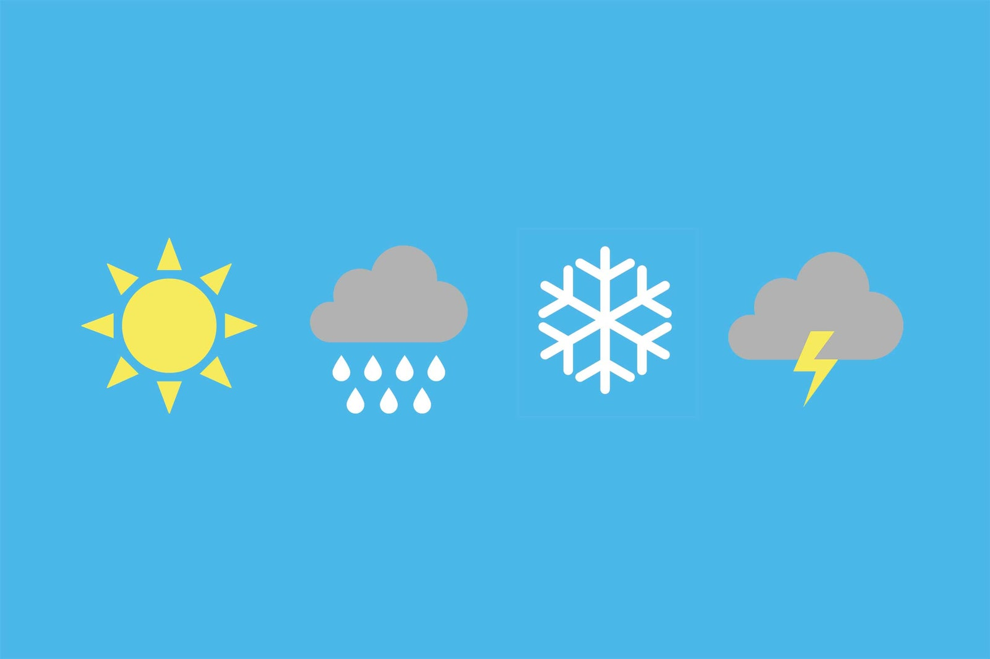
Weather at Major Cities
Group 9
Ani Thomas
Al Rehnaz
Monse Michael
Flask Web App

Slide 2



Contents
Project Topic
Team
Timeline
Tools used
Final Web Application

Slide 3


Our Team
Developers : Ani Thomas
Project Manager : Ani Thomas
Business Analyst : Monse Michael
Data Analyst : Al Rehnaz

Slide 4


Timeline
Get the data from Weather API
Create an account on Mongo DB Atlas.
Connect python with the cloud database and store data into Mongo DB.
Create an API to get data from live cloud database using Mongo DB Realm
Step 2
Step 4
Step 1
Step 3
Step 5
Load data into Python from API
Create visualizations using Google charts in a Flask web app.
Deploy the application to cloud using Heroku.

Slide 5


Weather at Major Cities - Parameters
Load data from the online site.
Loaded data into python.
Data format JSON.

Slide 6




Mongo DB Atlas
Create a MongoDB Atlas Cluster
Connect with MongoDB Atlas using python ‘pymongo’ module.
Upload Weather data to live database.

Slide 7
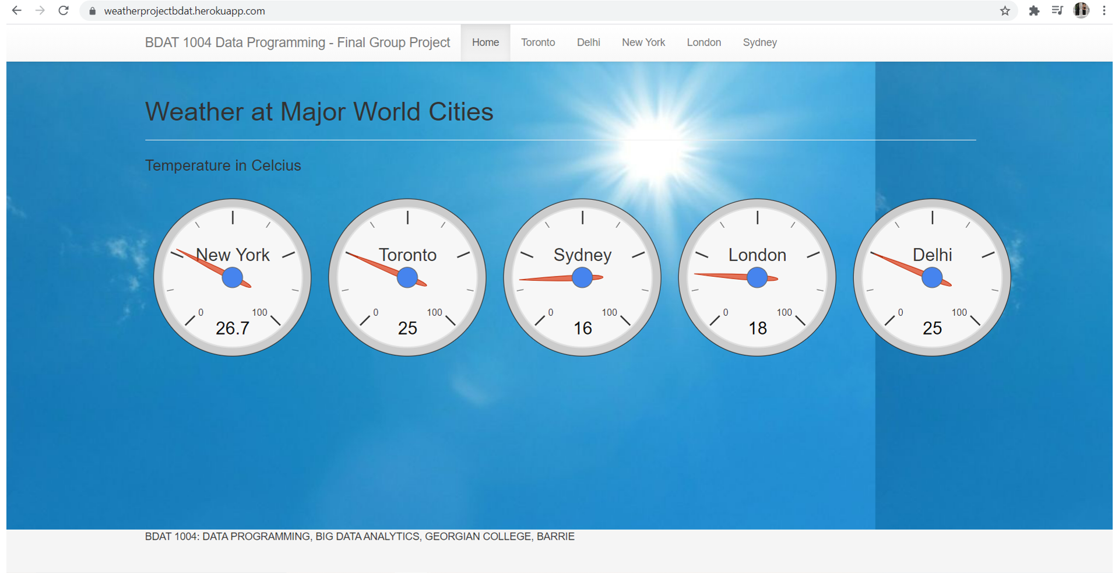
Flask Web Application Home Page

Slide 8
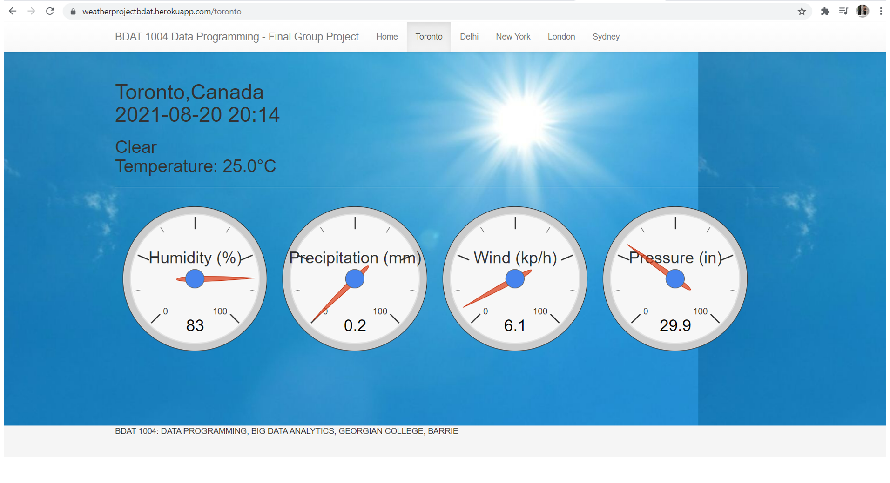
Flask Web Application Page for the city Toronto

Slide 9
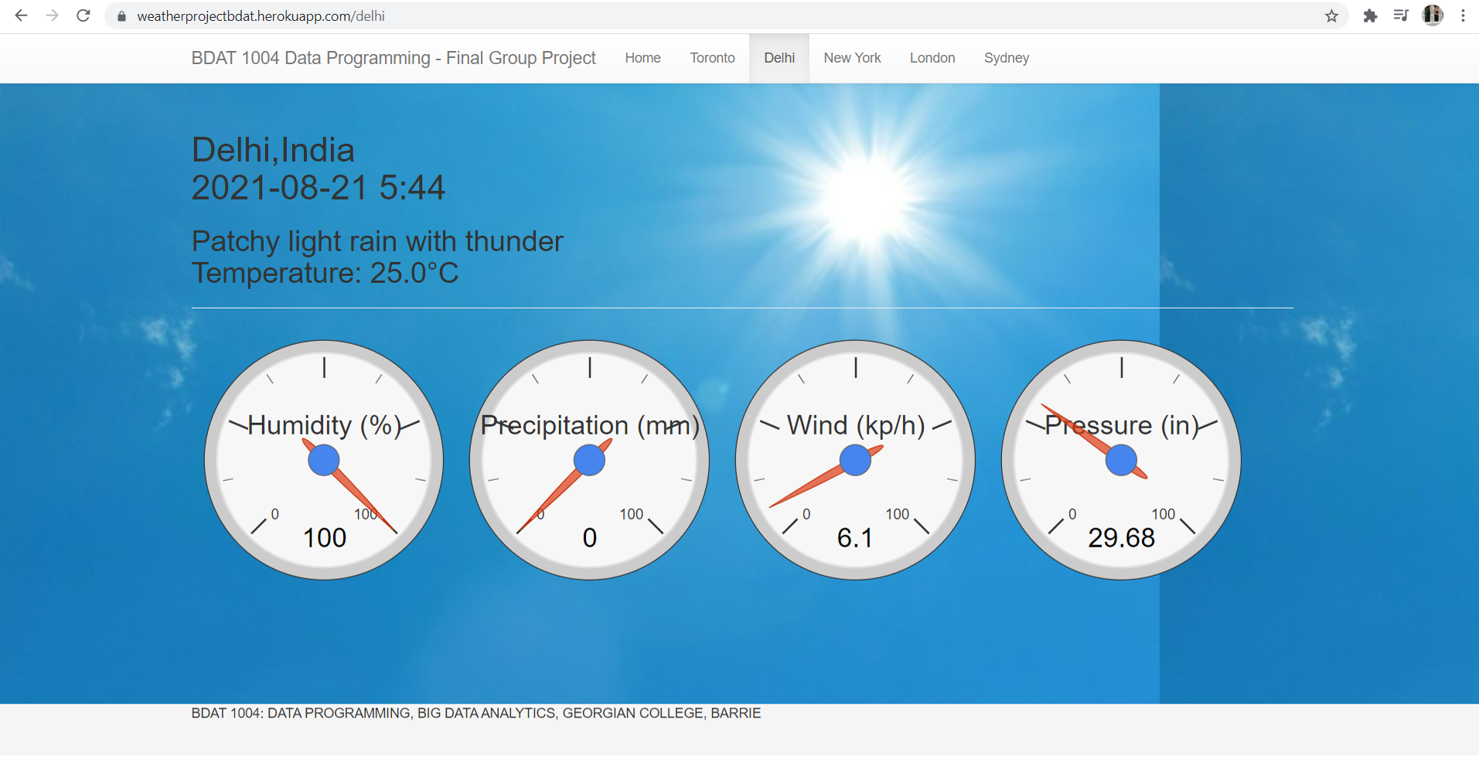
Flask Web Application Page for the city Delhi

Slide 10

Flask Web Application Page for the city New York

Slide 11
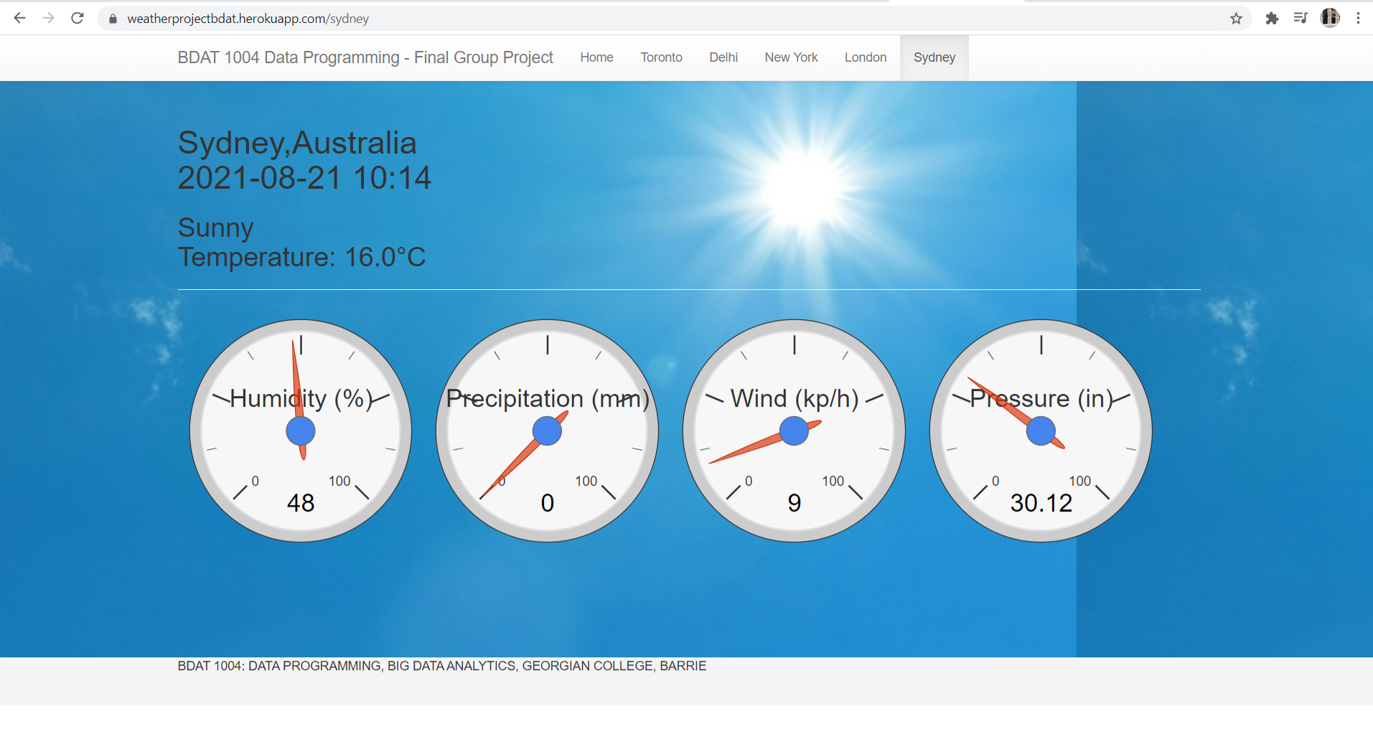
Flask Web Application Page for the city Sydney

Slide 12
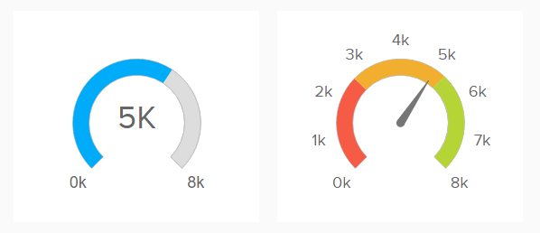
Google Chart Visualization
Gauge Chart

Slide 13


For Web Page Design
CSS
Java Script

Slide 14

API
Created an API to get data from MongoDB Atlas.
https://us-east-1.aws.webhooks.mongodb-realm.com/api/client/v2.0/app/application-0-hhqvq/service/apiweather/incoming_webhook/weatherapi

Slide 15

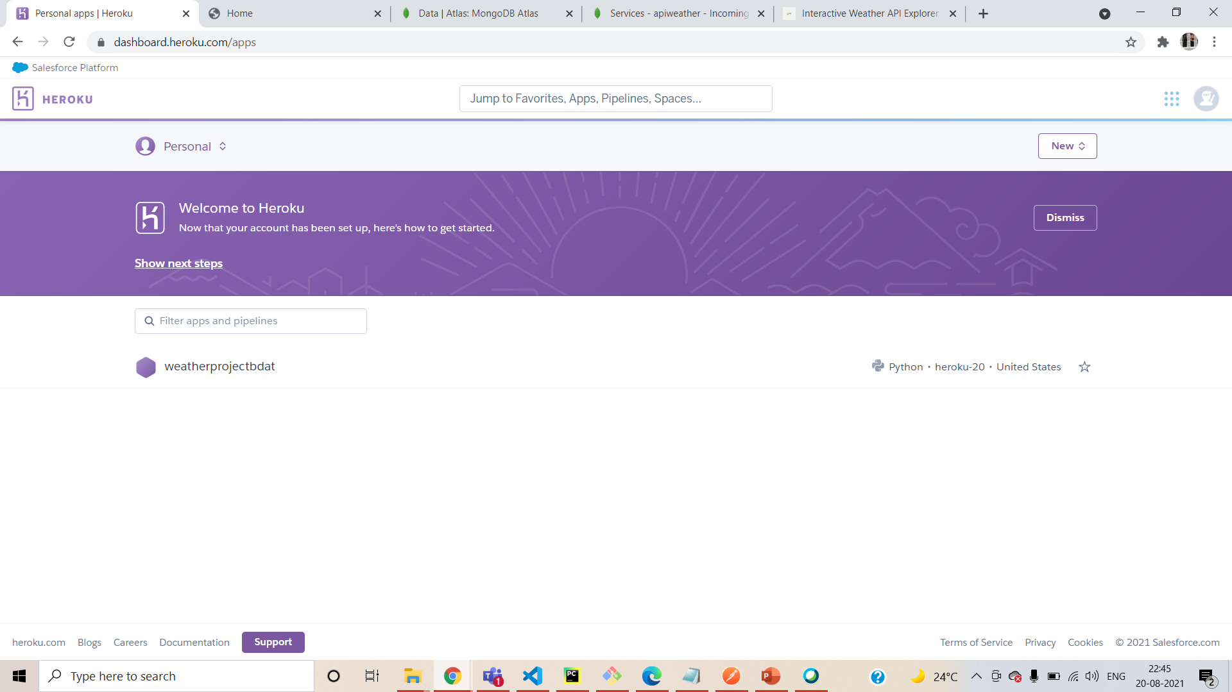
HEROKU
https://weatherprojectbdat.herokuapp.com/

Slide 16
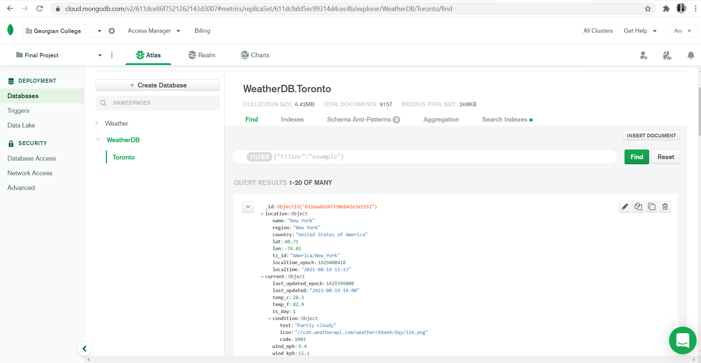
Live Data Stored on MongoDB Atlas

Slide 17
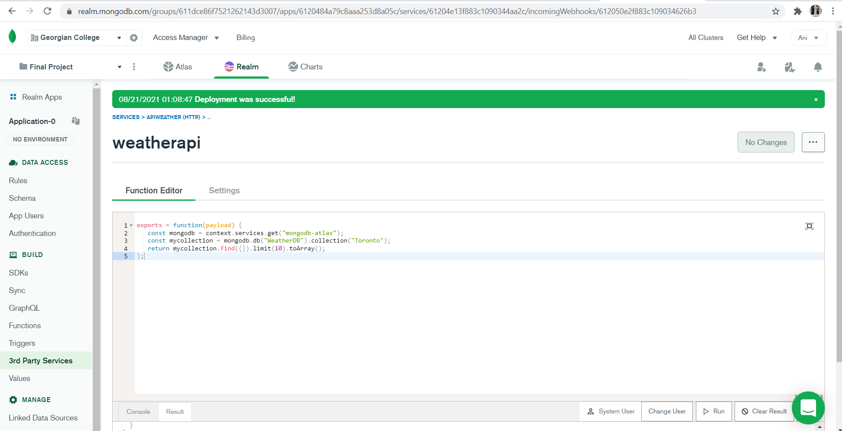
Creating an API using MongoDB Realm

Slide 18
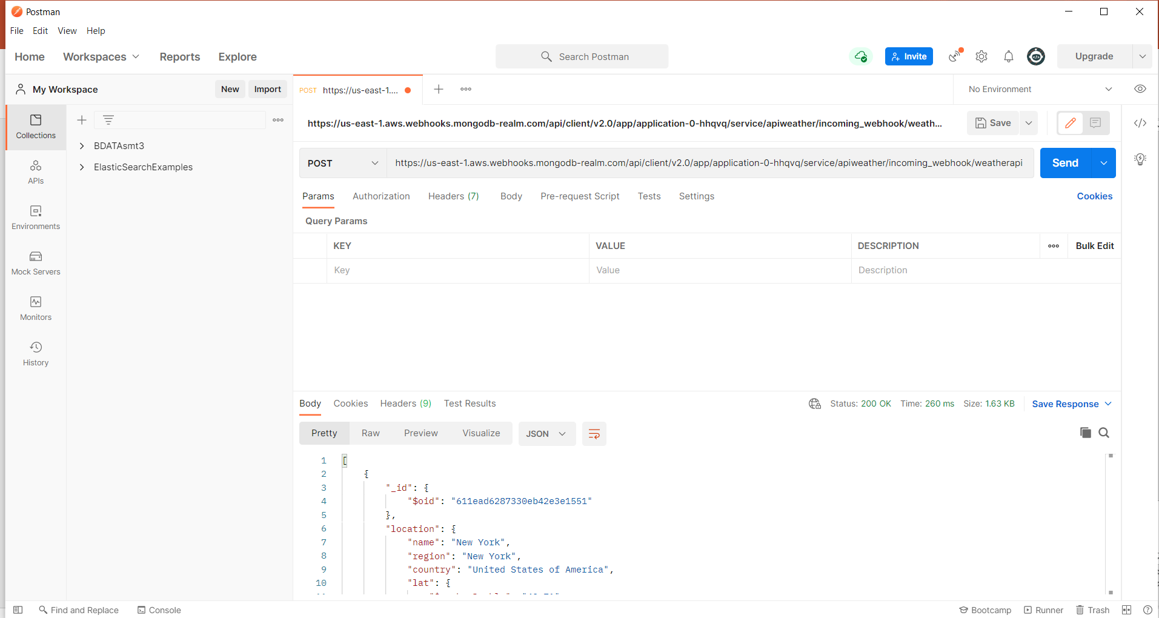
Getting live data from API using a key in Postman

Slide 19
Thank You

